Slide 1
QCC Personnel Downloader

Slide 2
Presenter Information
Allen Tang
Applications Systems Analyst
Santa Clara County Office of Education
allen_tang@sccoe.org
(408) 453-6714

Slide 3
What is Personnel Downloader?
Personnel Report Tool
Allows you to select data elements from personnel screens – MA, W4, CL, EA, etc.
Creates an MS Excel Spreadsheet
Notes:
After getting data from Personnel Downloader User can then manipulate and format the data in MS Excel

Slide 4
How does it Work?
Select fields from a list (Go “field shopping”!)
Can use filters or criteria on each field to limit data returned
Can place fields in any order
Can use preset selection criteria that have been saved (Like a collection of “shopping list”)
You can save your selection criteria to use again (Make your own “shopping list”)
Notes:
Emphasize Shopping List analogy.
Personnel Downloader will give you what you ask for. You select field data to download and it gives it to you.
Remind users that they can only get data from screens they normally have security access to in QCC.
Contrast with HR Report / Job Selector which has canned / premade reports.

Slide 5
Best way to learn
Look for and try out existing presets first
Modify existing preset field selection criteria
Start from scratch
Notes:
Mention that there are many existing presets.

Slide 6
Important Vocabulary
Download Maintenance
Where you save your preset collection criteria, and manage field selections for presets
Data Options
Where the files you created are saved and waiting to be downloaded. An important point is that these files do not auto-refresh. (It is similar to Print Manager for reports.)
Category Maintenance
A way to organize, group your preset selection criteria files.
Notes:
An important point is that although it is similar to Print Manager, the list of data files in Personnel Downloader does not auto-refresh

Slide 7
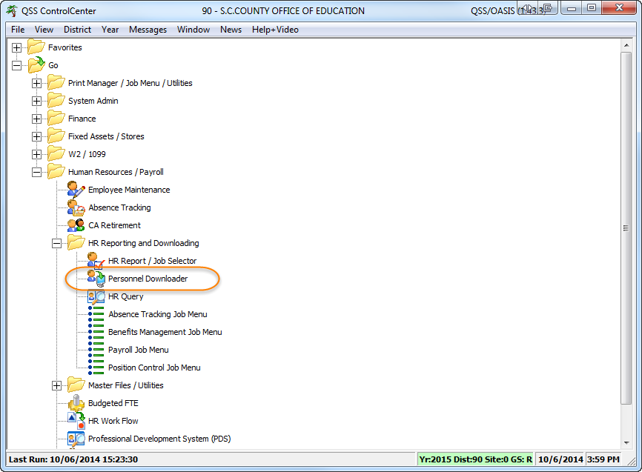
Where is the Personnel Downloader?

Slide 8
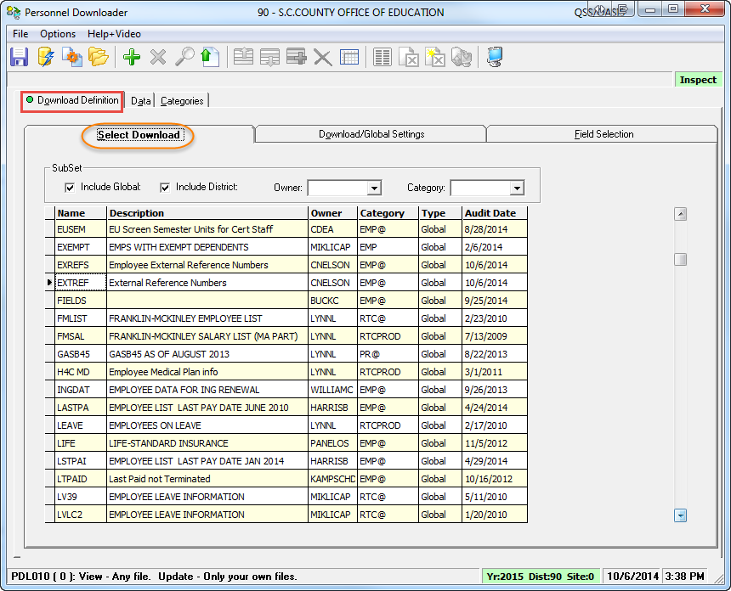
Download Definition Tab
Notes:
List of Presets

Slide 9
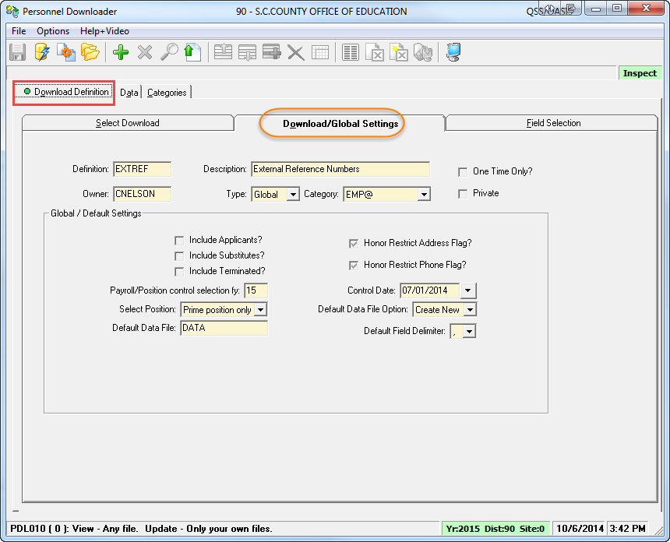
Download Definition Tab (cont.)
Notes:
On this screen, you can refine settings for your preset. This is especially important when you are using existing preset created by someone else.
-Can select Private to make it so you are the only person who can see the preset
-Update Payroll/Position control selection fy
-Update Control Date

Slide 10
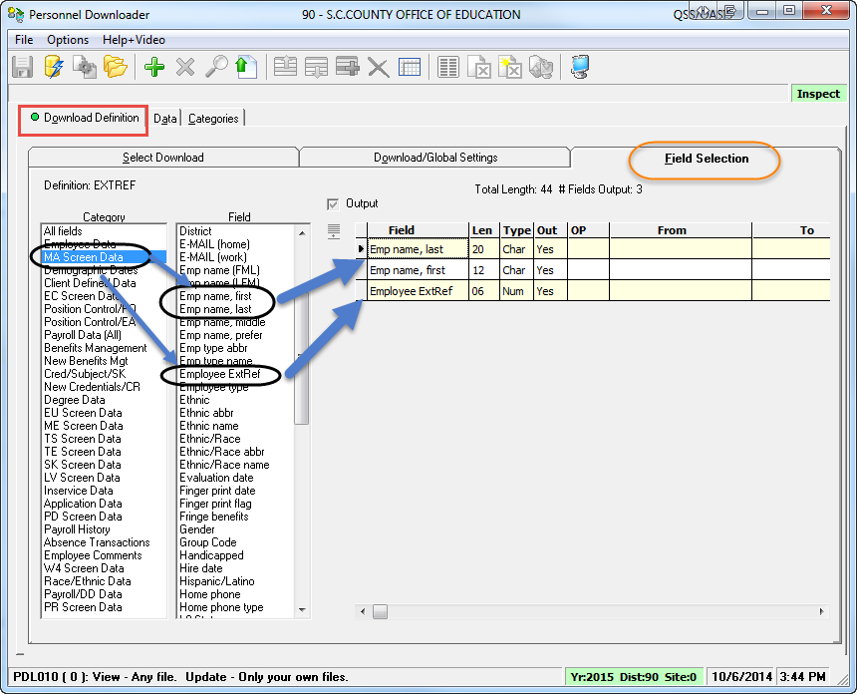
Download Definition Tab (cont.)
Notes:
Here is where you build your “shopping list” in Personnel Downloader.
This is where you “shop” for items or “fields” to include in your download. You will save the fields you select to a preset, which is your “shopping list”.

Slide 11
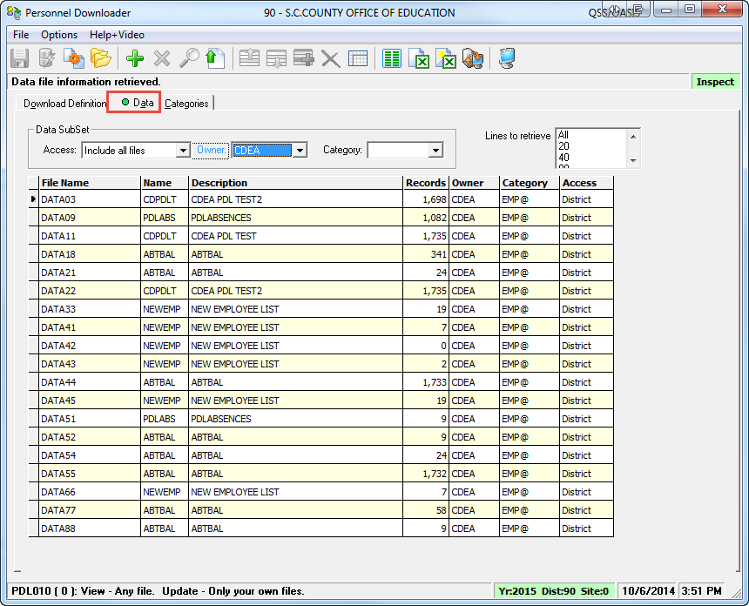
Data Tab
Notes:
Data file list does not auto-refresh. You need to click the “gear” to get new data files generated.
This is different from Print Manager which does auto-refresh with new files.

Slide 12
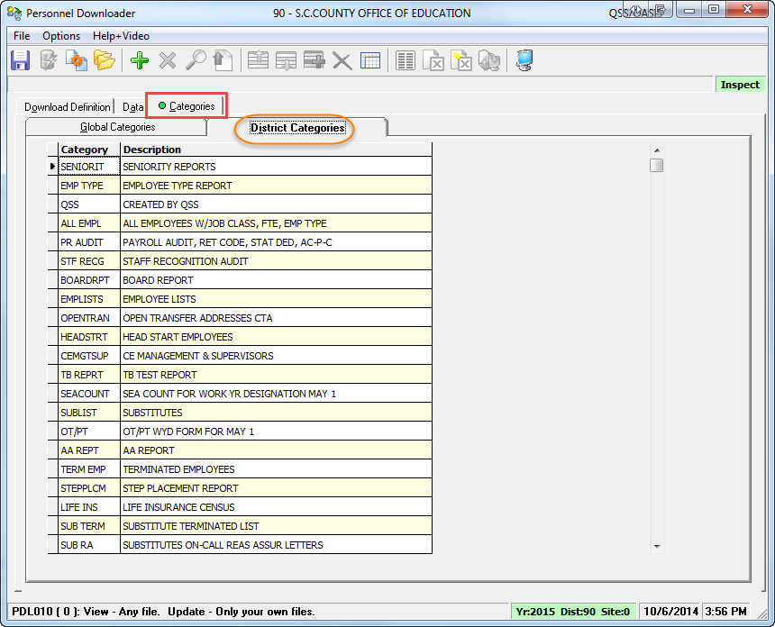
Categories Tab
Notes:
This is a somewhat optional capability. Your district should have at least an “EMP” and “@EMP” category.
Your district can use Categories to help you classify or group different types of presets.
You will a “Category” pull-download on the “Download/Global Settings” tab when you are adding or using a preset
Generally we suggest that you choose “@EMP” for the category.
When a category has an “@” sign it does what’s called an “outer join” in database terminology.
Let’s say you are getting a list of employees and one of the fields you are downloading is for a bonus code field.
If you include the category with the “@” it will include the employee in the data download even if she has nothing in that bonus code field. Whereas if you selected the category without the “@” it would leave off the employee from the download if she has no bonus code.

Slide 13
Personnel Downloader Process Overview
QSS PERPAY DB
Submit Download Definition
Build/View Data files
Categories Downloads
Data files
Download Data files
Maintain Download Definitions
Analyze & Manipulate Data Using PC Tools
Maintain Categories

Slide 14
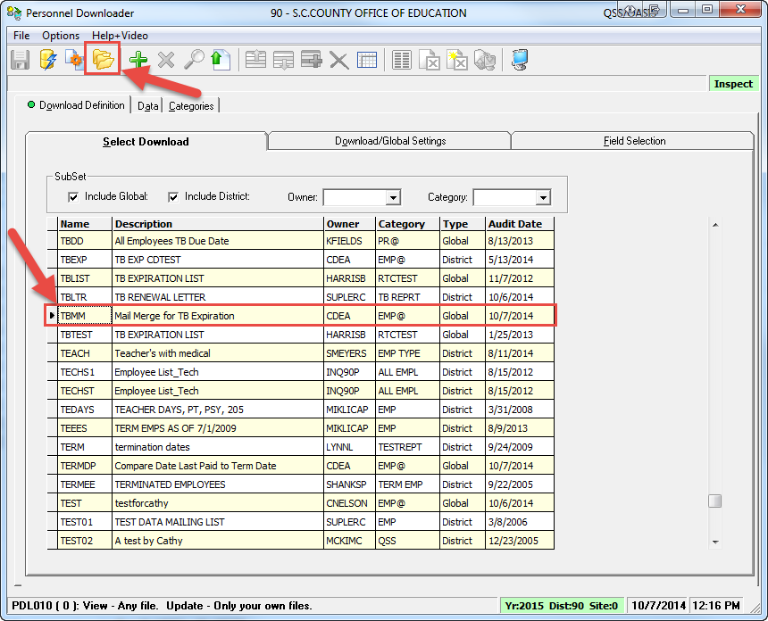
Example #1: Mail Merge for TB Letter
Select TBMM and click on Open Download Definition icon
Notes:
To quickly find a preset
-If you know owner’s USERID, select the person’s USERID (e.g. “CDEA”) from the “Owner” pull-down menu then click the “Gear” (Get List of Definitions button).

Slide 15
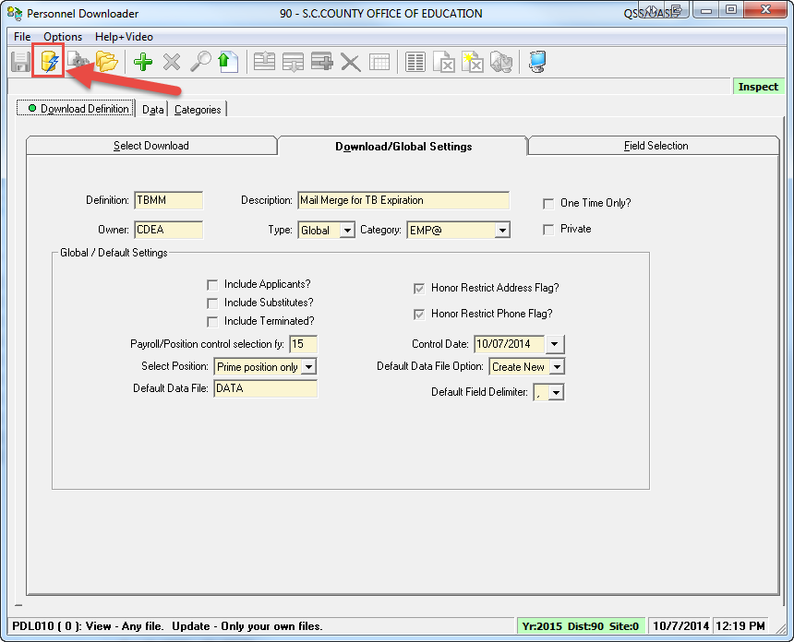
Example 1: Download/Global Settings Screen
Click the Submit Job to Create Data File icon
-if you do not need to modify the preset

Slide 16
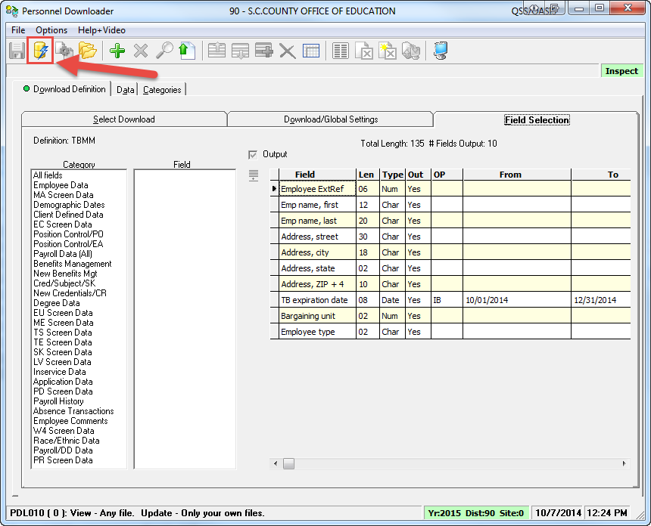
Example 1: Field Selection Screen
Click the Submit Job to Create Data File icon
Notes:
Recommend that they do not alter fields on Global Presets under my “CDEA” USERID.
Instead make new presets of their own, referring to mine or others as needed.

Slide 17
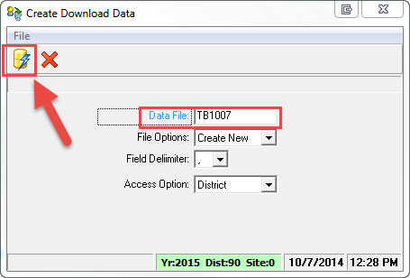
Create the Download File (cont.)
Enter a name for the Data File
Click the Submit Job to Create Data File icon
Notes:
Mention that Data File name needs to be unique (6 characters). If you get “File already exist” error, just enter a slightly different name to make a unique name.

Slide 18
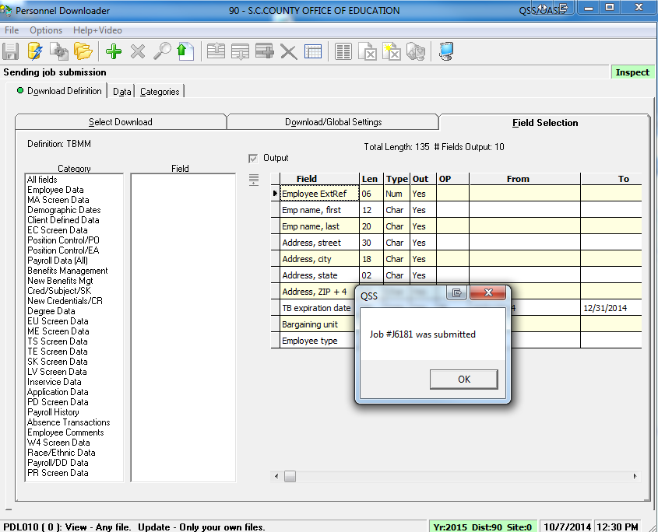
Create the Download File (cont.)
Click OK

Slide 19
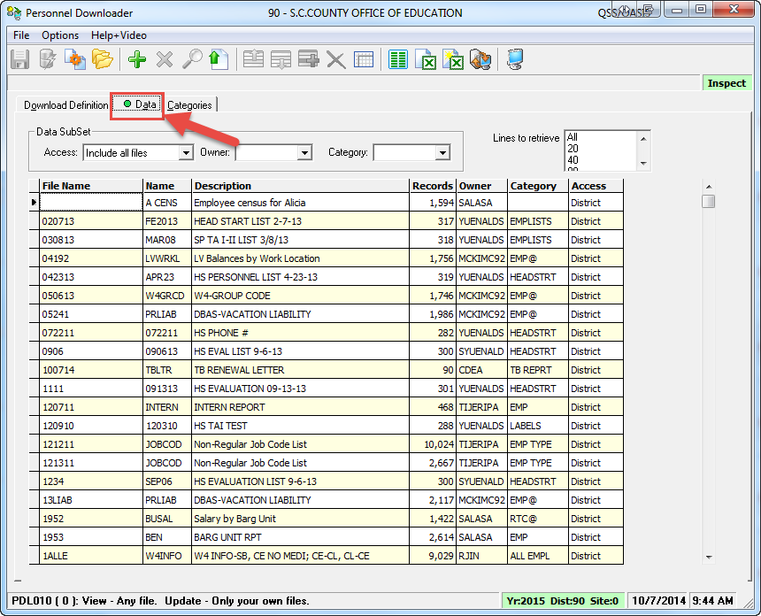
Download File into Excel
Click on Data tab
Notes:
The Data tab is like the Print Manager except it holds data downloads created via the Personnel Downloader.

Slide 20
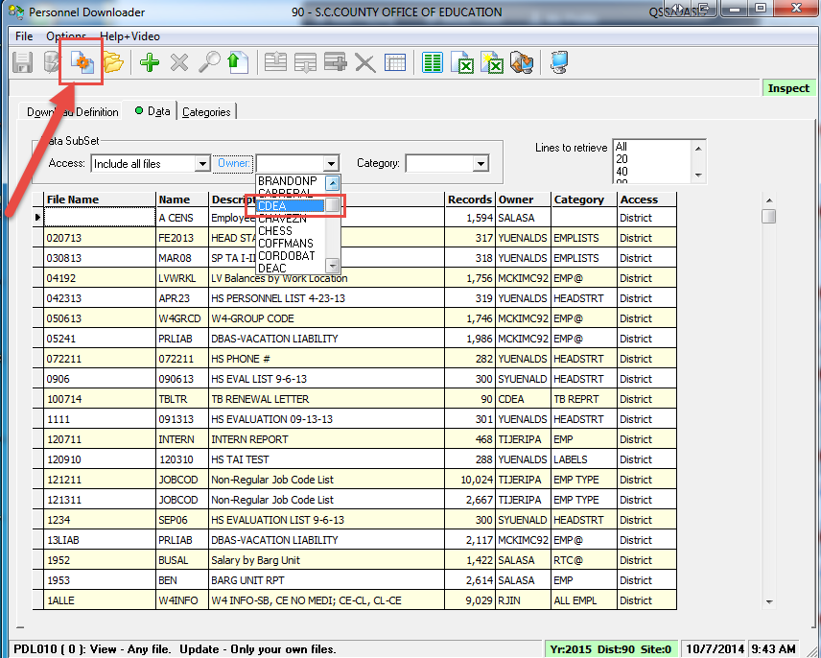
Download File into Excel (cont.)
Locate your QCC USERID from the Owner pull-down
Click Get List of Data Files button

Slide 21
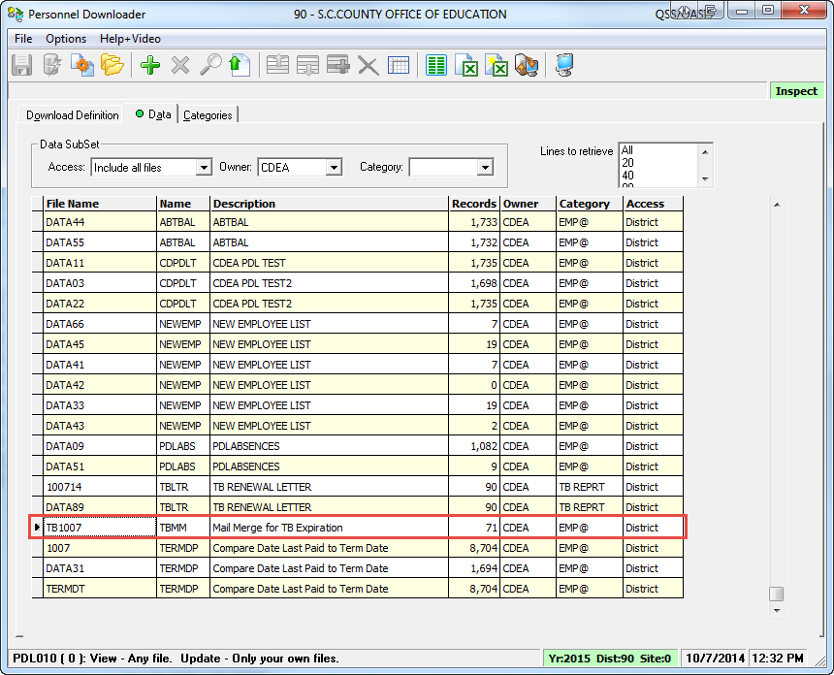
Download File into Excel (cont.)
Locate and click to select the new Data file

Slide 22
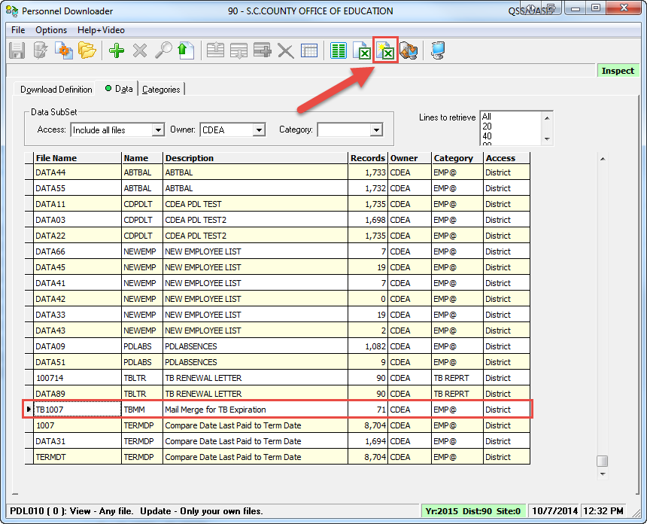
Download File into Excel (cont.)
Click on “sunny” Excel Wizard icon
Notes:
Tell user to see “arrow” next to selected Data download
User can click on “Options” -> “Include Field Headings” if she wants to include Field (Column) headings in the data download.

Slide 23
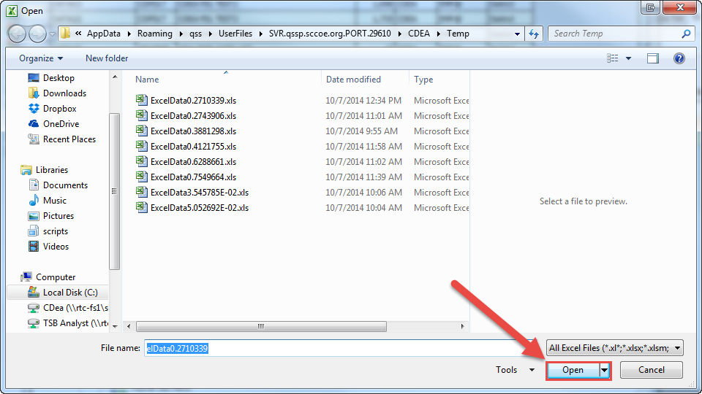
Download File into Excel (cont.)
Click on Open
DO NOT change the filename

Slide 24
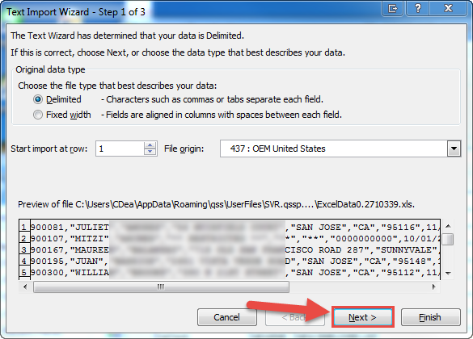
Download File into Excel (cont.)
Click Next

Slide 25
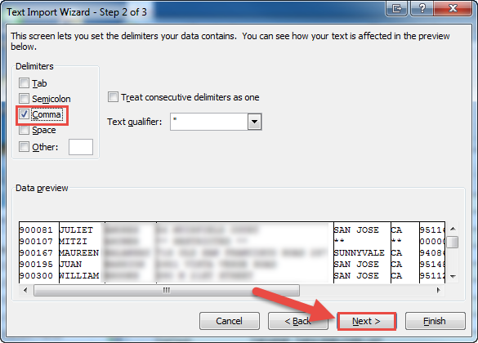
Download File into Excel (cont.)
Select Comma delimiter and click Next
Notes:
Tell user to look at Data preview area to see what data will look like.

Slide 26
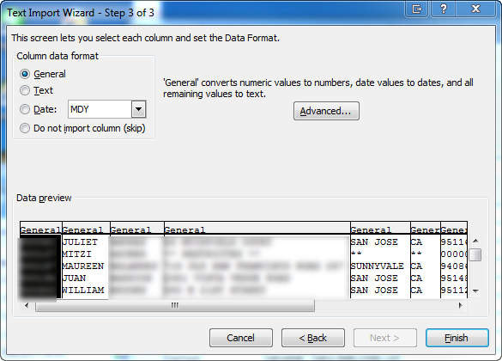
Download File into Excel (cont.)
Select all columns: press <SHIFT> and click on last column

Slide 27
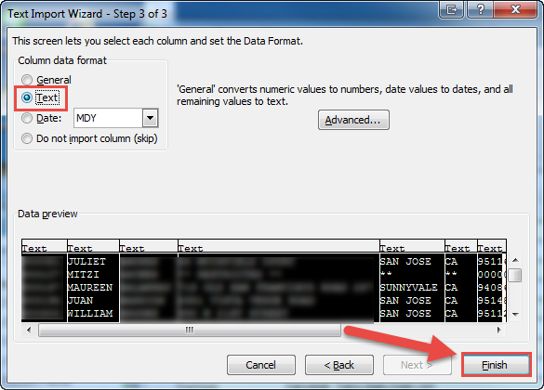
Download File into Excel (cont.)
Select Text radio button
Click Finish

Slide 28
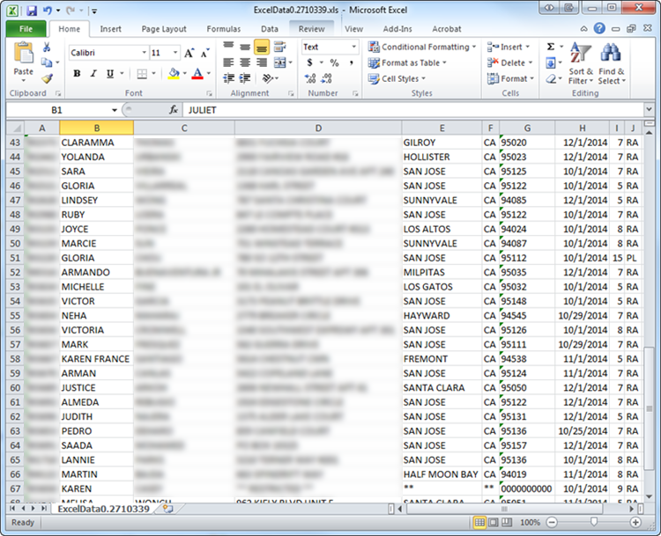
Excel File Created
Use Excel to format your file
Notes:
User can add column headings in Excel.

Slide 29
Using Selection Rules
Filter the data you download using operators
Have Personnel Downloader only give you a specific subgroup of data matching the rule/operator
Eliminate some extra work in Excel

Slide 30
Operators
Operator | Defination
EQ | Equal To
NE | Not Equal To
GT | Greater Than
LT | Less Than
GE | Greater than or equal to
LE | Less than or equal to
IB | In between
NI | Not in between

Slide 31
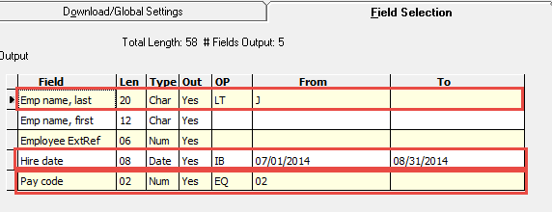
Example of Using Selection Rules(cont.)
What are we going to get out?

Slide 32
Example of Using Selection Rules(cont.)
We will get employees that meet all these criteria:
Employee’s with last names A – I
Employees hired between 07/01/2014 and 08/31/2014
Employees with Pay code of 02, Classified Employees

Slide 33
Going forward…
Try out some existing presets
Modify field selection criteria on presets to fit your needs
Create your own presets from scratch
Notes:
Tell users they cannot break anything since they are just dumping data out, they are not modifying data in the system.
Also they can take screenshots (using FastStone Capture) to take a picture of fields on other presets to use as reference.

Slide 34
Thank you!

